Slide 1



NANO-SATELLITE COMMUNICATION SUB-SYSTEM
GROUP No:W11
Date:25/9/2021

Slide 2




Team Composition
Kanick Dinesh | PES1201801907
Rutwik Ganagi | PES1201800627
Adarsh S | PES1201801775
Ayush Mishra | PES1201800664
Guide : Dr. G Nagendra Rao, Director, CRSST

Slide 3
Contents
Problem Statement
Motivation
Literature Survey
Working Principle
Implementation of Progress
Schematic
Custom Layout
PC104 Standard Layout
CLTU packet format
Results
Deliverables
Appendix: Bill of Materials
Conclusion
Project timeline Gantt Chart
References

Slide 4
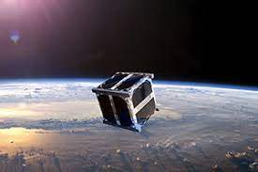
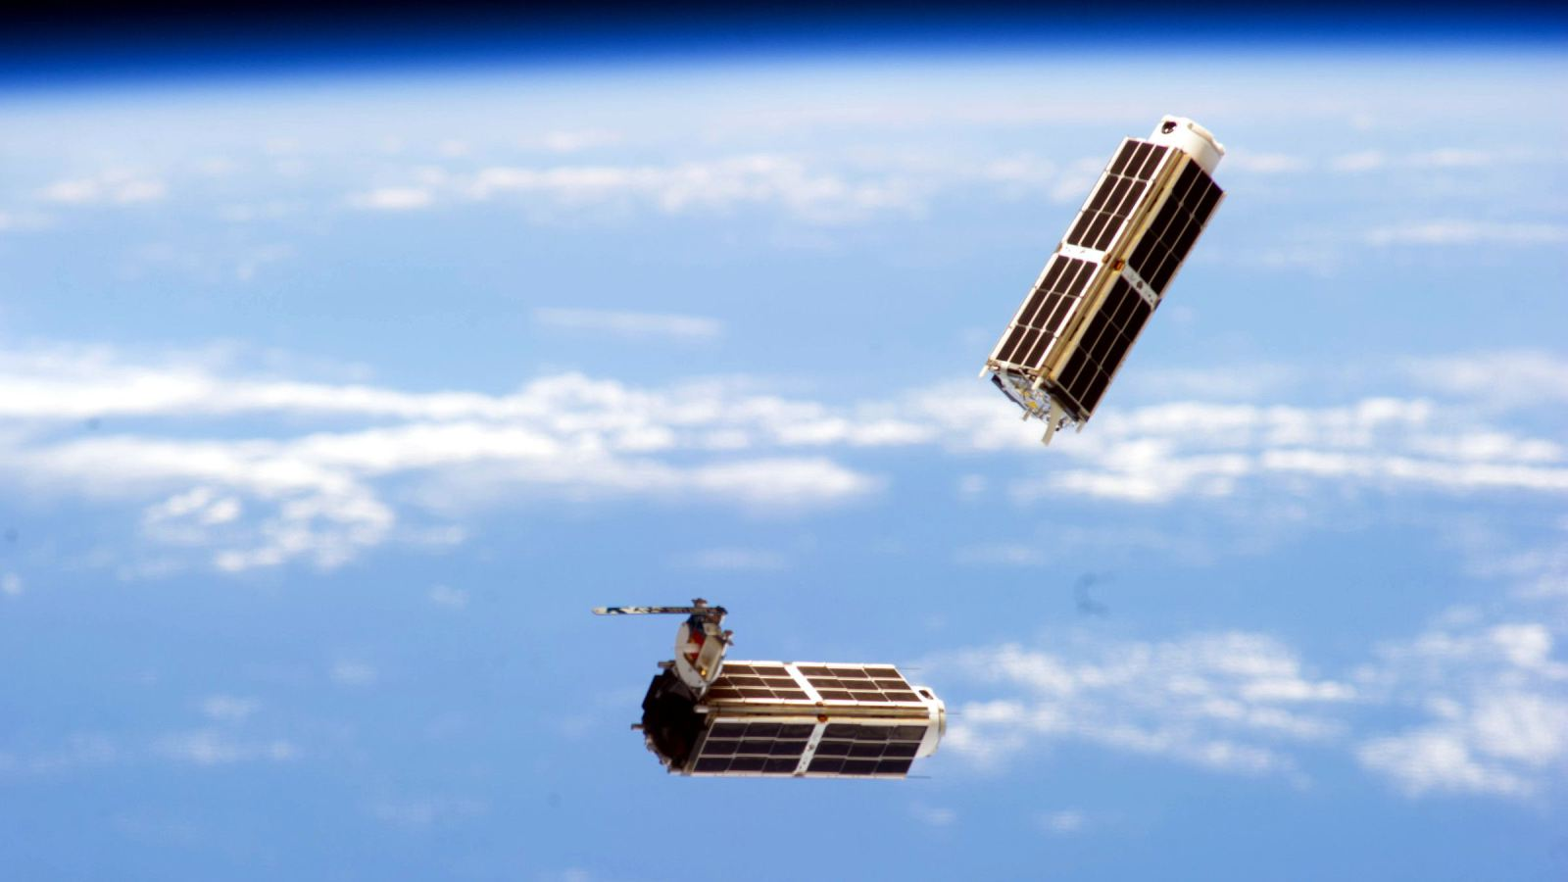
Problem Statement
To design a Low power transceiver for communication in nanosatellites, using inexpensive and widely available commercial components, operating in the UHF band(433MHz).

Slide 5
mOTIVATION
Communications subsystems are thought to contribute to at least 29% of CubeSat failures in the first 90 days on-orbit.
Thus, COMMS sub-system is an integral part of a satellite and is expensive, the improved design will incorporate commercially available parts which are inexpensive and which consumes less power.

Slide 6
Literature survey
[1] Y. A. I. Humad, A. TagElsir and M. M. Daffalla, "Design and implementation of communication subsystem for ISRASAT1 Cube Satellite," 2017 International Conference on Communication, Control, Computing and Electronics Engineering (ICCCCEE), Khartoum, 2017, pp. 1-4, /ICCCCEE.2017.7867651.
Abstract: communication system of the cube satellite is divided into two subsystems which are telemetry and data subsystem{UHF band at 868 MHz }, and beacon subsystem{in VHF band at 128 MHz}.
The Beacon signal is generated using AVR MCU within audio frequency and then modulated using FM modulator, Telemetry and Data subsystem will send the mission and telemetry data to the ground stations as digital packets.
Salient features: Maximum transmission power of 1 W.
Carrier frequency 868 MHz; ISM band.
Interface: TTL 1 RS232/ 485 by the user select.
Channel rate 4800 bps.

Slide 7
[2] A. A. Doroshkin, A. M. Zadorozhny, O. N. Kus, V. Y. Prokopyev and Y. M. Prokopyev, "Experimental Study of LoRa Modulation Immunity to Doppler Effect in CubeSat Radio Communications," in IEEE Access, vol. 7, pp. 75721-75731, 2019
Abstract: This paper presents the results of laboratory testing and outdoor experiments conducted to determine the feasibility of the LoRa modulation in CubeSat radio communication systems. The experiments showed that the LoRa modulation has very high immunity to the Doppler effect. This immunity allows for the use of LoRa modulation in satellite radio communications in orbits above 550 km without any restrictions associated with the Doppler effect.
A software-defined radio transmitter and a standard LoRa receiver were used for laboratory testing and experimental studies of the radio link utilizing the LoRa modulation. They used a modular NI PXIe-5672 radio frequency vector signal generator by National Instruments Corporation as a SDR transmitter, and a LoRa transceiver based on the SX1278 chip by the Semtech Corporation as a receiver and demodulator.
The experiments have shown that the LoRa modulation can be used in the radio communication between the ground station and a satellite in a circular orbit more than 550 km in height without any restrictions associated with the Doppler effect. Hence, we have planned to use SX1278 transceiver for our project as it can provide both LoRa modulation as well as FSK modulation with excellent dynamic range RSSI.

Slide 8
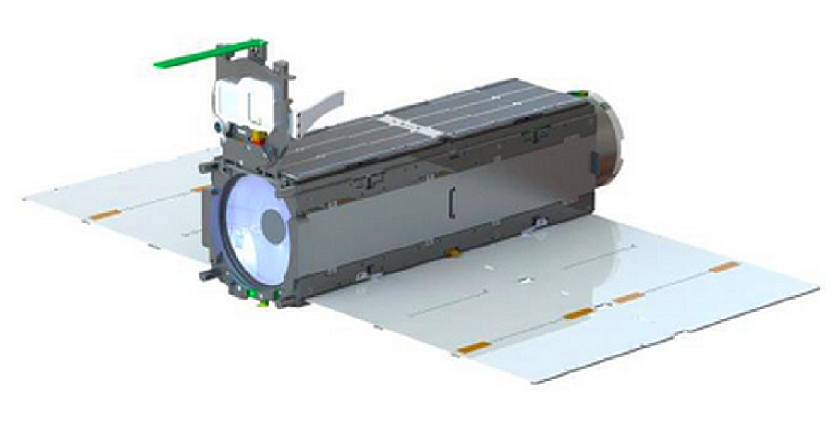

[3]OPENLST: Planet-labs has released OpenLST, an open radio solution for communicating with remote instruments, vehicles, and stations using low-cost commercial components. OpenLST builds on experience gained from Planet’s UHF radio, which has been successfully integrated and used on over 200 satellites in space. Using this radio, Planet has contacted 100 percent of its successfully deployed Dove CubeSats.
Webpage link: https://www.planet.com/pulse/planet-openlst-radio-solution-for-cubesats/
Our project is based on the COMMS subsystem developed by Planet-labs.

Slide 9
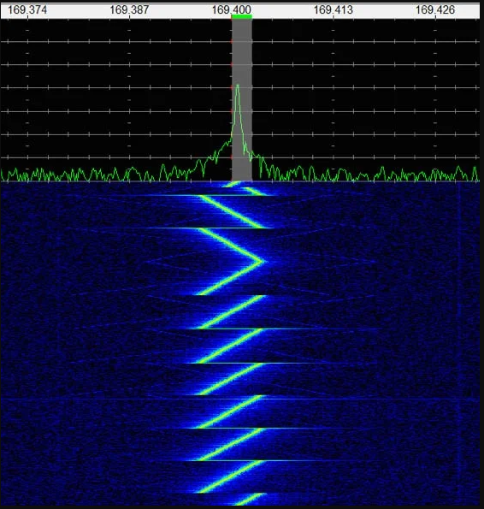
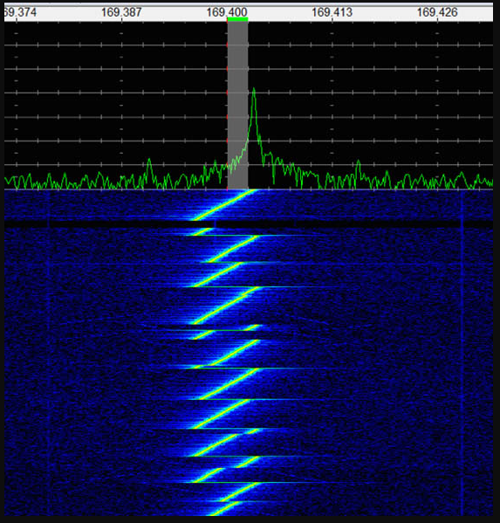
Working principle
LoRa modulation works on the principle of frequency modulated (FM) chirps. A stable chirp is generated using a frac-N phase lock loop (PLL).
In order to achieve “lock” to the LoRa signal, a long “constant chirp” preamble is transmitted.
Once a LoRa modem has “locked” on to the preamble signal, the end of the preamble is signalled by the “reverse chirp” seen in Figure 1.
Then the data transmission begins, which has a series of “symbols” that function much like M-ARY FSK symbols, but instead happen on a chirp. See Figure 2.
There is no selectivity between a preamble from one LoRa transmitter vs. another. If there is a constant chirp at the right frequency and at the right chirp rate, a LoRa demodulator will listen to it, whether its from the intended system or not.
Fig 1 : LoRa Chirp
Fig 2 : LoRa Data Modulation

Slide 10
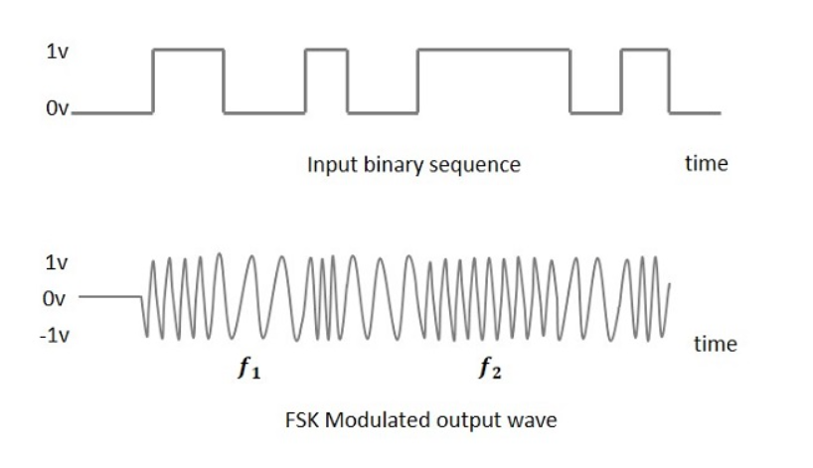
fsk Modulation
Frequency Shift Keying is the digital modulation technique in which the frequency of the carrier signal varies according to the digital signal changes. FSK is a scheme of frequency modulation.
The output of a FSK modulated wave is high in frequency for a binary High input and is low in frequency for a binary Low input. The binary 1s and 0s are called Mark and Space frequencies.
The modulated signal consists of the following two different carriers.
S₁(t) = A_{c} cos(2π(f_{c}-Δf)t)
S₂(t) = A_{c} cos(2π(f_{c}+Δf)t)
The following image is the diagrammatic representation of FSK modulated waveform along with its input.
Fig 3: FSK Modulation

Slide 11
Phase-2 Implementation
1. Updated Schematic of Communication Sub-System
2. Complete Layout Design of Communication Sub-System of Prototype-1
3. Complete Layout Design of Communication Sub-System of Prototype-2
4. Implementation of BCH Encoding
5. Fabrication and Soldering of PCB

Slide 12
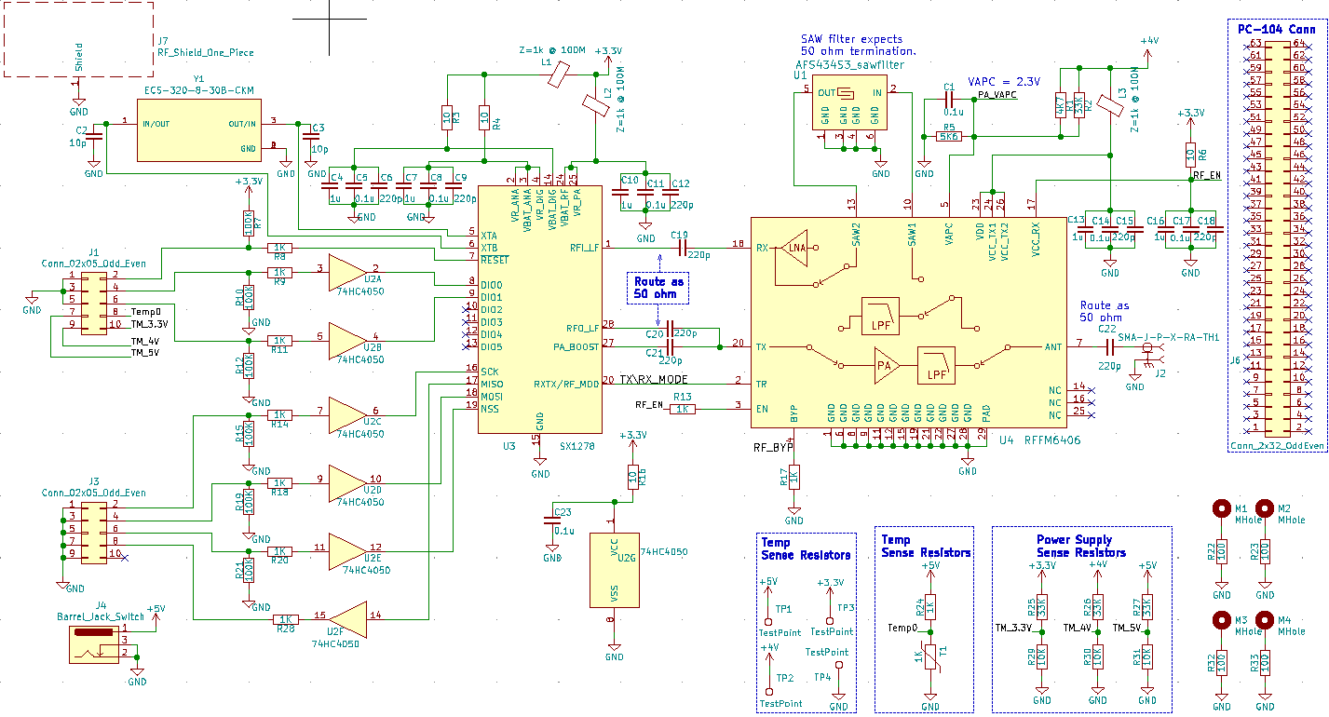
Fig 4: Comms board Schematic

Slide 13
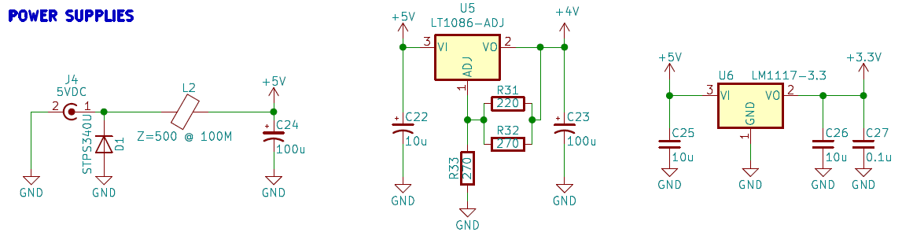
POWER SUPPLY BLOCK
1.
2.
3.
Fig 5: Voltage generation schematic
The 3 circuits shown above are responsible for generating all voltages required for operating the various components of the board.
External 5V line is decoupled and passed into a ferrite bead for high frequency filtration.
5 V line is passed into a 4Vregulator , giving a decoupled output for PA block.
5V line is passed into a 3V3 regulator, giving a decoupled output for RF device.

Slide 14
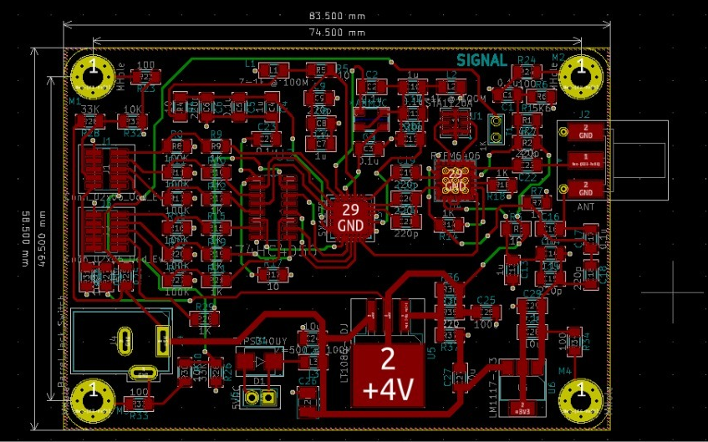
Layout specifications – Custom {Prototype-1}
Settings
Track width:
Signal: 14 mils
Rf line: 13.8mils
Power line: 40mils
Via size: .8mm
Drill size: .4mm
Number of layers: 4
Top
GND
3.3V
Bottom
Dimensions: 83.5×58.5{mm}
Fig 6: KiCAD Layout editor view

Slide 15
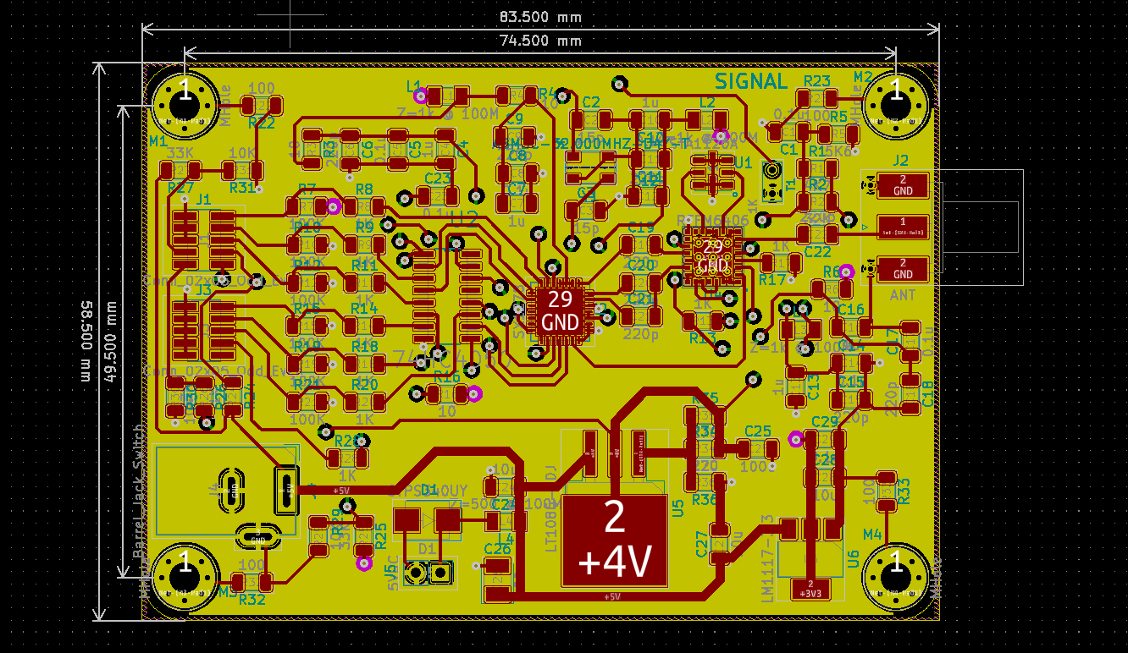
Layout Design
Fig 7: Layout filled view

Slide 16
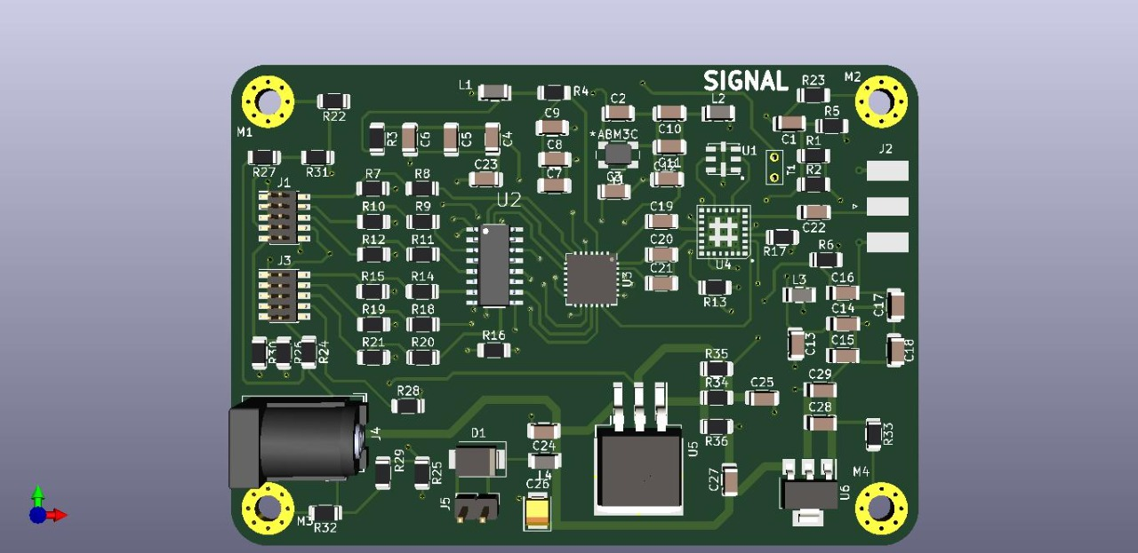
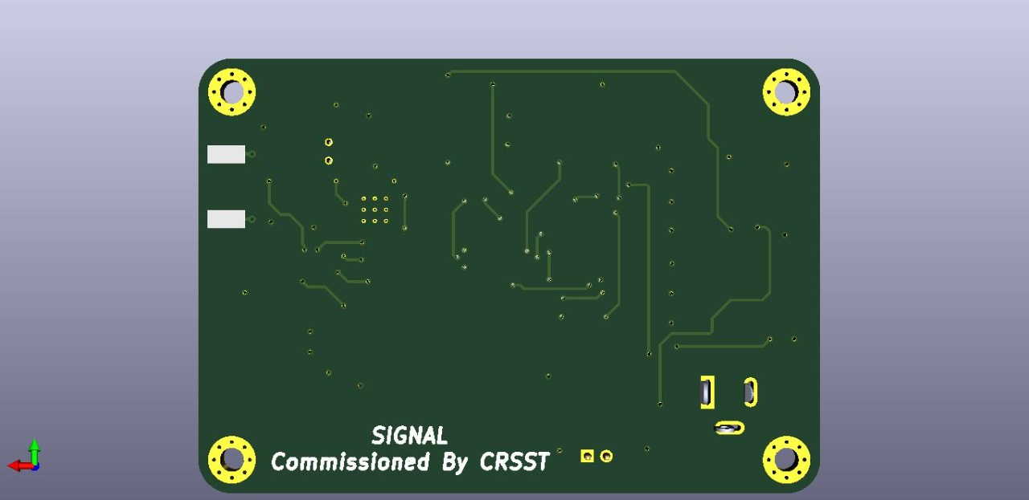
Layout {3D View}
Fig 8: Front View
Fig 9: Rear View

Slide 17
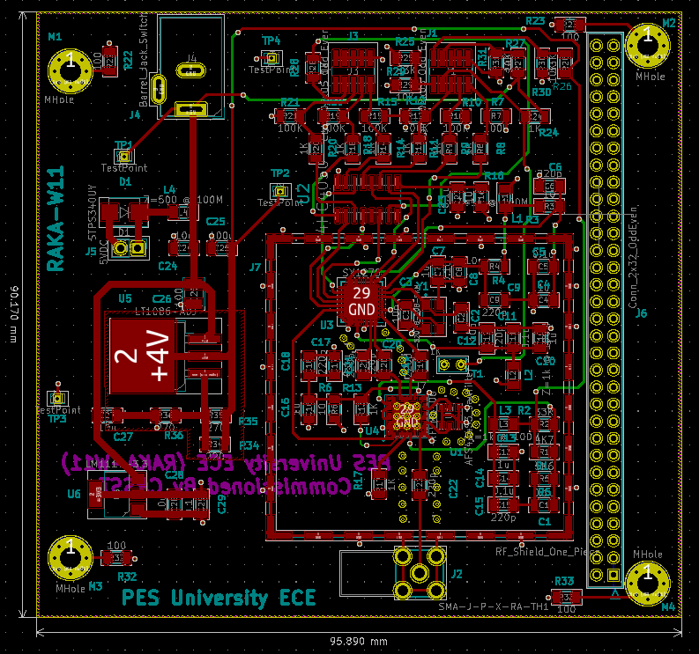
Layout specifications – PC104 standard {Prototype-2}
Settings
Track width:
Signal: 14 mils
Rf line: 13.8mils
Power line: 40mils
Via size: .8mm
Drill size: .4mm
Number of layers: 4
4V
GND
3.3V
Bottom
Dimensions: 95.890×90.170{mm}
Features
Based on PC104 Standard
RF Shield
Via Stitching
Fig 10: KiCAD Layout editor view

Slide 18
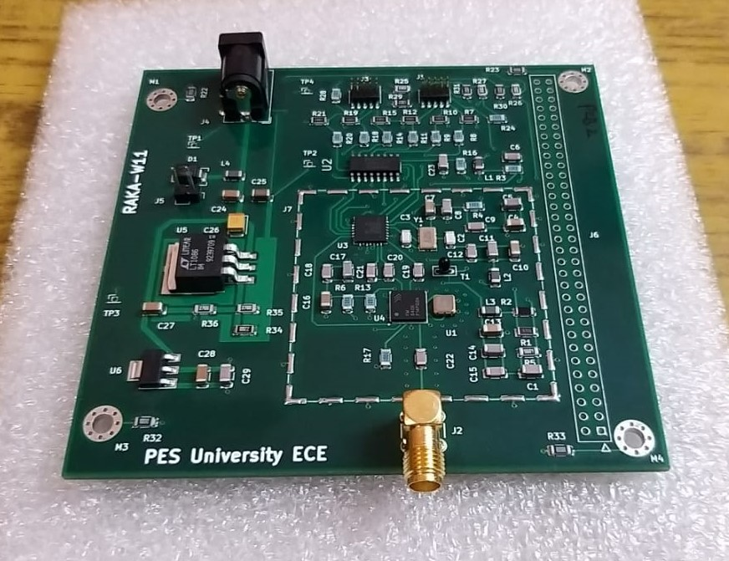
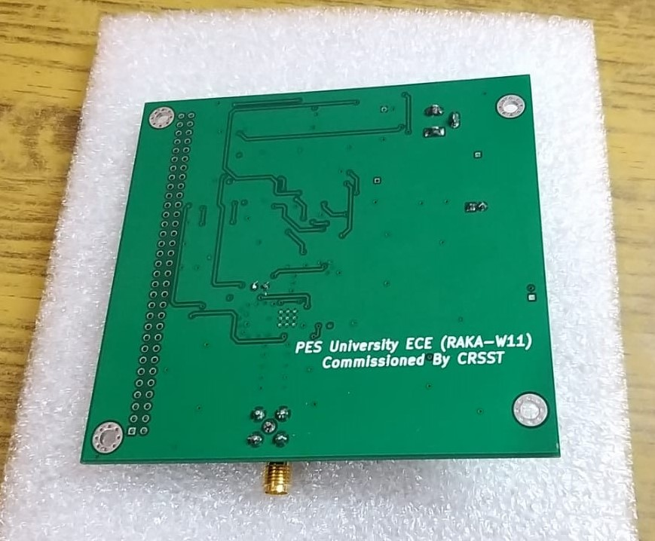
Nano-sat card
Fig 11: Front View
Fig 12: Rear View

Slide 19
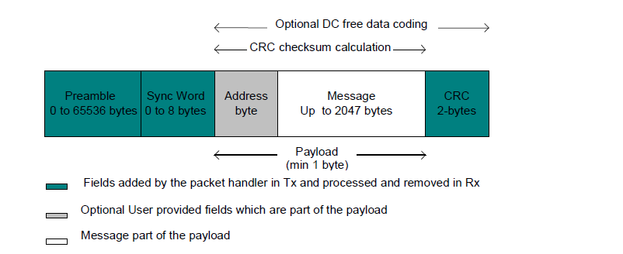
Packet Format
Fig 13: Fixed Length Packet Format
An illustration of a fixed length packet is shown above. It contains the following fields:
Preamble (1010...)
Sync word (Network ID)
Optional Address byte (Node ID)
Message data
Optional 2-bytes CRC checksum

Slide 20
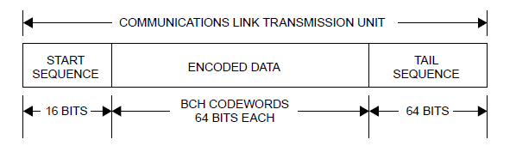
COMMUNICATIONS LINK TRANSMISSION UNIT
Fig 14: Components of the CLTU when BCH Coding Is Used
The BCH codeword format is a fixed-length data entity. The codeword is formulated using a systematic coding technique which contains 56 information bits in the leading octets, and the error control bits in the last octet. The BCH codeword contains an integer number of octets with an overall length of 8 octets (64 bits).
Synchronization for the codeword and delimiting of the beginning of user data are provided by the Communications Link Transmission Unit (CLTU) data structure.
The CLTU is the data structure which carries the data as a contiguous series of encoded codewords across the Synchronization and Channel Coding Sublayer.

Slide 21
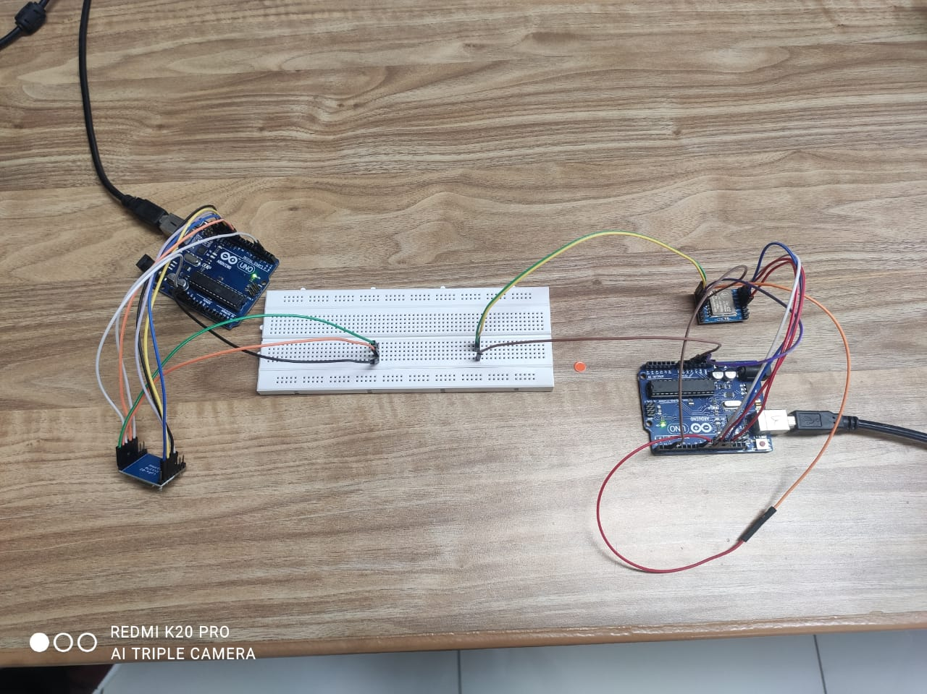
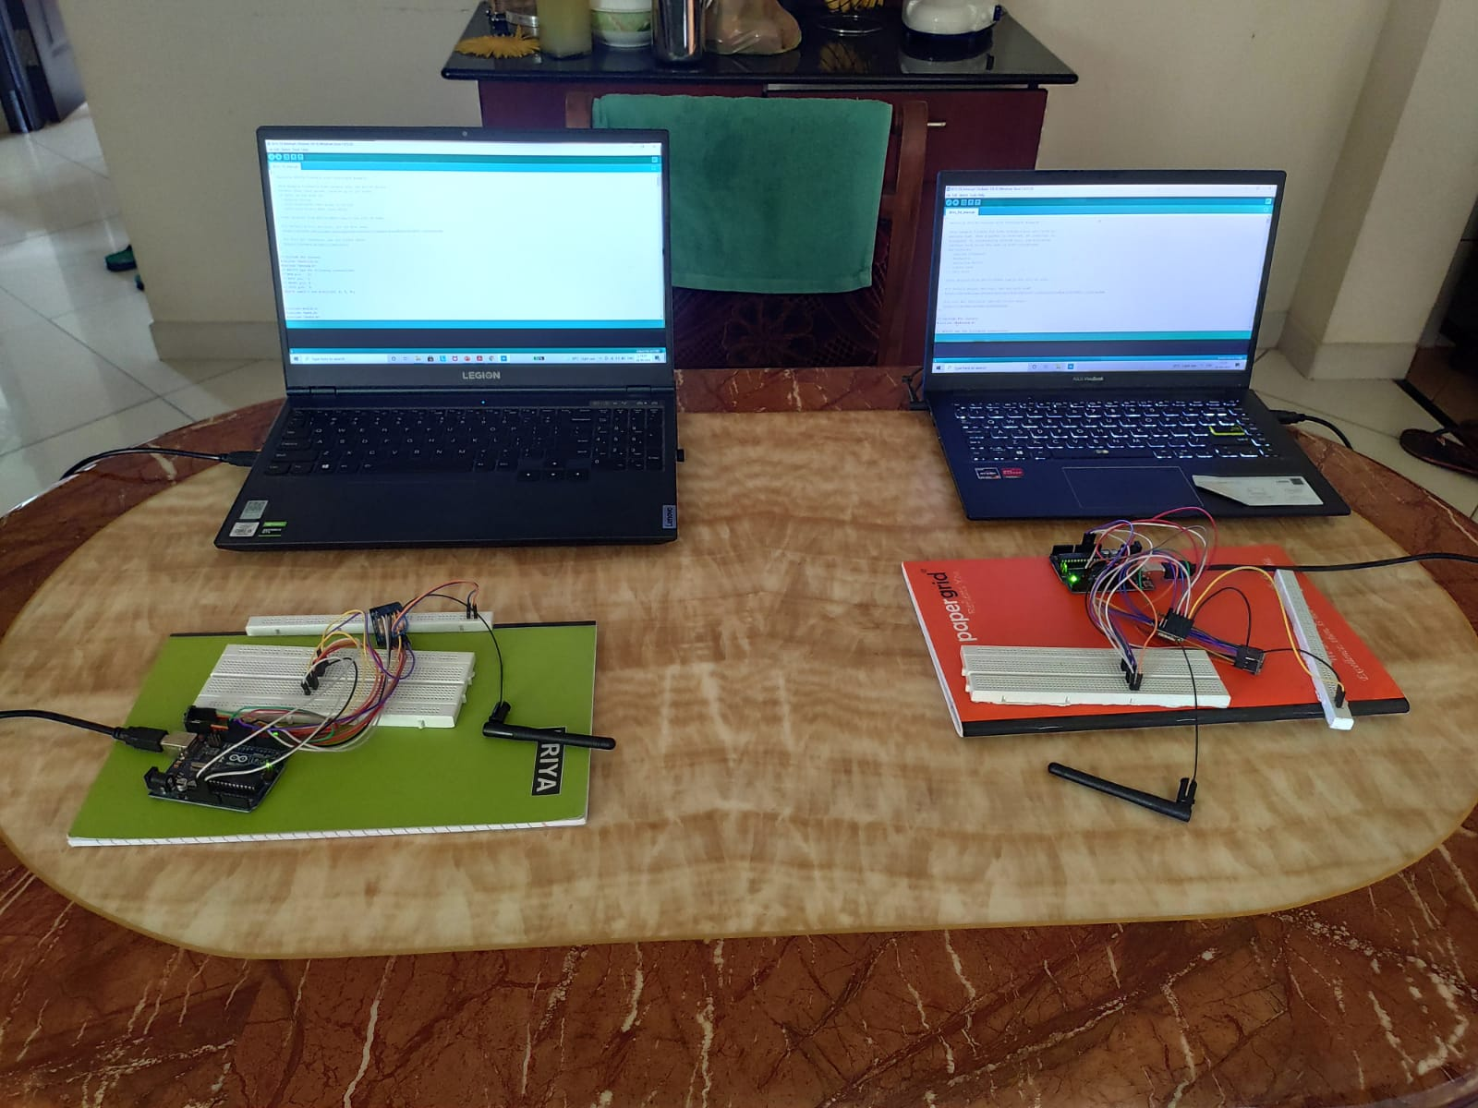
Hardware-Setup
Phase-1
Phase-2
Fig 15: Phase-1 Setup
Fig 16: Phase-2 Setup

Slide 22
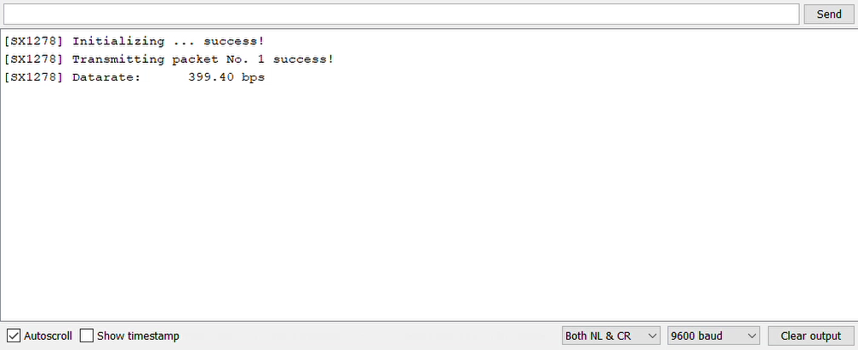
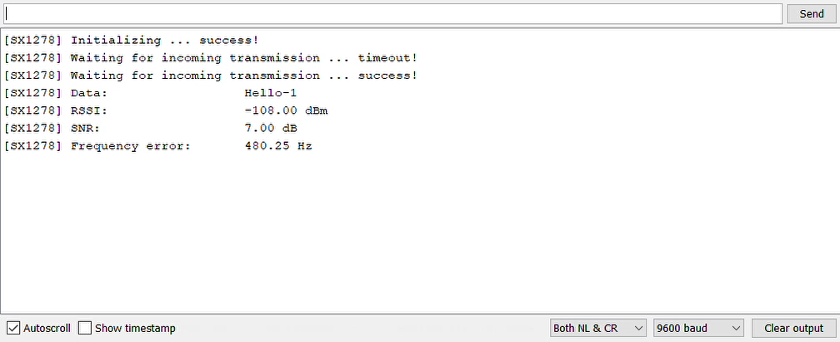
Demonstration lora-modulation {Phase-1 Results}
Video 1: Transmitter Output
Video 2: Receiver Output

Slide 23
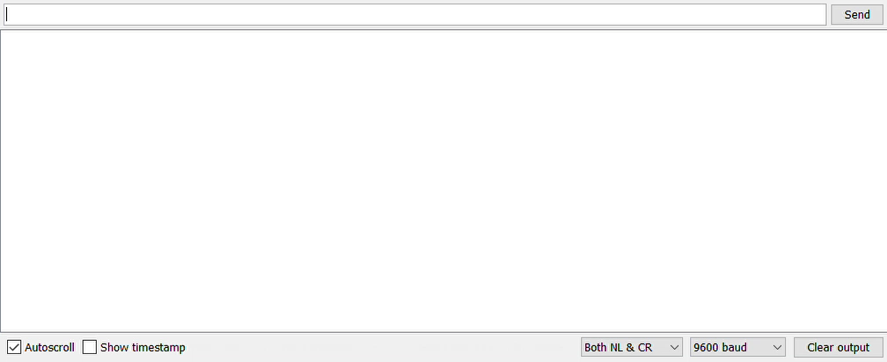
BCH encoding Results
Video 3: Transmitter Output {FSK Modulation}

Slide 24
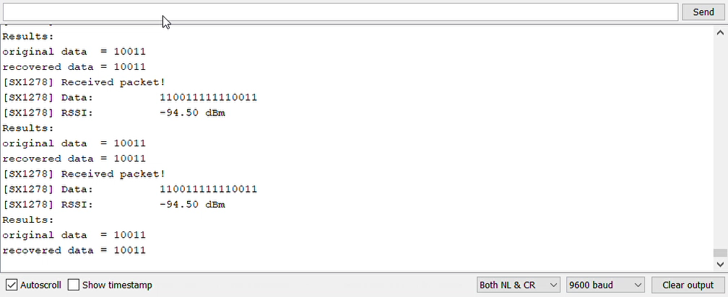
BCH Decoding Results
Video 4: Receiver Output {FSK Modulation}

Slide 25
SNR Calculations
C/N = EIRP - FSL + 10 log (G_{r}) - 10 log (T_{s}) - 10 log (K) - 10 log (B)
C/N = 10 log (P_{t}) + 10 log (G_{t}) - 20 log (4πR/λ) + 10log (G_{r}) - 10 log (T_{s}) – 10 log (k) - 10 log(B)
λ = (3*10⁸)/ (434*10⁶) = 0.691 m K = 1.38 * 10⁻²³ m²kgs⁻²k⁻¹ (Boltzmann Constant)
R = 1000 km (Satellite Altitude) = 10 log (K) = 10 log (1.38 * 10⁻²³) = -228.6 dBJ/K
FSL = 20 log(4πR/0.691) = 145.19 db T_{s} = 483 K (Temperature of the System)
B = 125 kHz (Bandwidth) = 10 log (483) = 10 log (483) = 26.8 dB/K
= 10 log(B) = 10 log (125*10³) = 50.969 db
P_{t} = 32dBm = 2 dB (Transmitter Power)
C/N = 10 log (P_{t}) + 10 log (G_{t}) - 20 log (4πR/λ) + 10 log (G_{r}) – 10 log (T_{s}) – 10 log (k) – 10 log (B)
= 2 + 10 log (G_{t}) - 145.19 +10 log (G_{r}) - 26.8 + 228.6 - 50.969
= 7.641 + 10log (G_{t}) + 10 log (G_{r})

Slide 26
Deliverables
Phase-1
January-February
Primary Literature Review
March
Methodology finalization
April
Short Range Testing using LoRa Modulation
May
Short Range Testing using FSK Modulation
Phase-2
JUNE
Schematic design of Communications card
JULY
Completed layout design of PCB Prototype-1
August
Completed layout design of PCB Prototype-2
September
Fabrication and Soldering of PCB
BCH Encoding Implementation

Slide 27
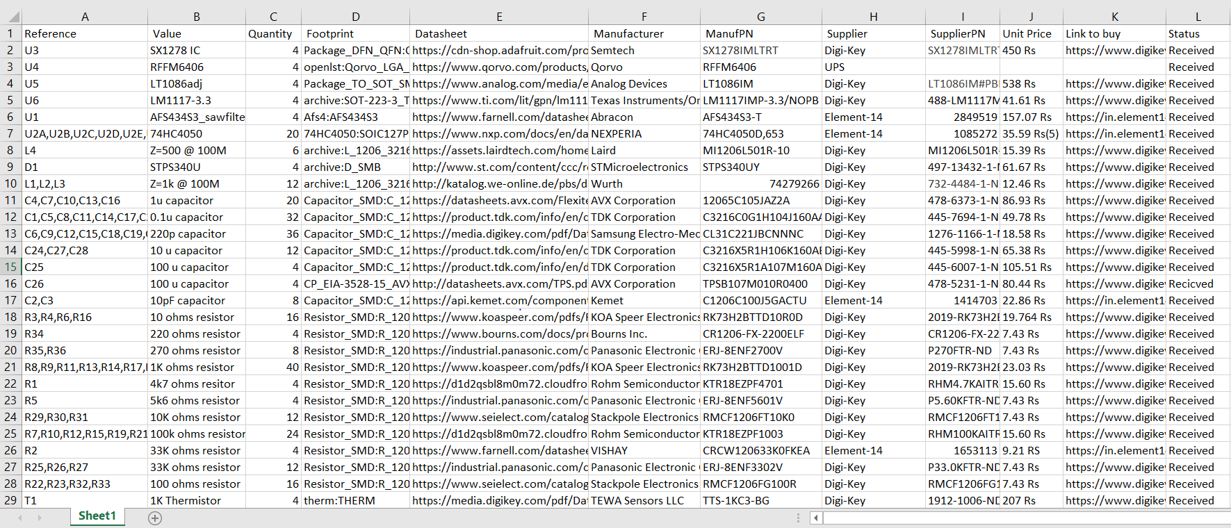
Appendix: Bill of materials
Table 1: BOM report

Slide 28
conclusion
Ground testing results have shown that a communications link has been established with an SNR of 6.5db{ no antenna, 10 m range}
The testing of the nano-sat cards is going on as of writing this document.
Long range tests will shed light on any range limitations of our design. Further, the effects of weather-related phenomena have not been documented and will be part of future developments.

Slide 29
Project Timeline (Gantt Chart)
Jan
2021
Mar
2021
May
2021
June
2021
July
2021
Aug
2021
Sept
2021
Literature Survey
Finalization of Methodology
Short Range
Testing
KiCAD Schematic
PCB Layout Design Prototype 1 & 2
Fabrication / BCH
Encoding Implementation
Report Writing

Slide 30
references
[1] A. A. Doroshkin, A. M. Zadorozhny, O. N. Kus, V. Y. Prokopyev and Y. M. Prokopyev, "Experimental Study of LoRa Modulation Immunity to Doppler Effect in CubeSat Radio Communications," in IEEE Access, vol. 7, pp. 75721-75731, 2019
[2] Gui F, Yin Y, Lu A .“ Research on Ship Wireless Communication Technology Based on LoRa”. In 2018 2nd IEEE Advanced Information Management, Communicates, Electronic and Automation Control Conference (IMCEC) 2018 May 25 (pp. 976-979). IEEE.
[3] R. Trüb, R. Da Forno, T. Gsell, J. Beutel and L. Thiele, "Demo Abstract: A Testbed for Long-Range LoRa Communication," 2019 18th ACM/IEEE International Conference on Information Processing in Sensor Networks (IPSN), 2019, pp. 342-343.
[4] https://www.semtech.com/products/wireless-rf/lora-core/sx1278#download-resources - SX1278 Datasheet
[5] https://www.qorvo.com/products/d/da000807 - RFFM6406 Datasheet
[6] https://www.analog.com/media/en/technical-documentation/data-sheets/1086ffs.pdf - LT1086 Datasheet
[7] OPENLST https://www.planet.com/pulse/planet-openlst-radio-solution-for-cubesats/
[8] https://www.ti.com/lit/gpn/lm1117 - LM1117 Datasheet
[9] https://www.nxp.com/docs/en/data-sheet/74HC4050.pdf - 74HC4050 Datasheet
[10] https://sawtron.com/portfolio/rf-139-999mhz/- SAW filter datasheet
[11] https://www.youtube.com/watch?v=0fteCxn5XXA

Slide 31
Submissions-W11
PROJECT REPORT –Completed
PROJECT POSTER – Completed
PROJECT VIDEO – Completed
INDIVIDUAL CONTRIBUTION –Completed
PROJECT DIARY - Completed

Slide 32
Individual contribution
Kanick Dinesh | PES1201801907 |  | Headed methodology analysis post literature review. Assisted in implementation of LORA and FSK modulation schemes on ground testing kit. Headed PCB design for finalized sub system and conducted preliminary tests of fabricated PCBs.
Rutwik Ganagi | PES1201800627 |  | Hardware Setup, BCH Encoding and Decoding, Ordering of the components, Doppler Shift and SNR Calculations, Finding footprints for the Layout, assisting in schematic and layout.
Adarsh S | PES1201801775 |  | Research on methodology, Entire Schematic and Layout Implementation, literature review, implementation of FSK, conducted preliminary tests on the fabricated boards
Ayush Mishra | PES1201800664 |  | Balun research, Buying Components, research on components, literature review, editing of video and poster.

Slide 33
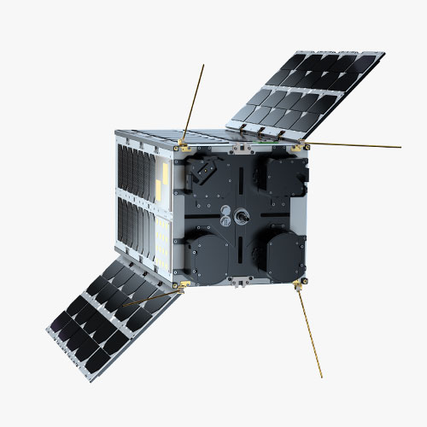

Thank You
**1/**2: operated on testing-equipment{ ATmega328p+ Ai-Thinker Ra02 module}

